Slide 1
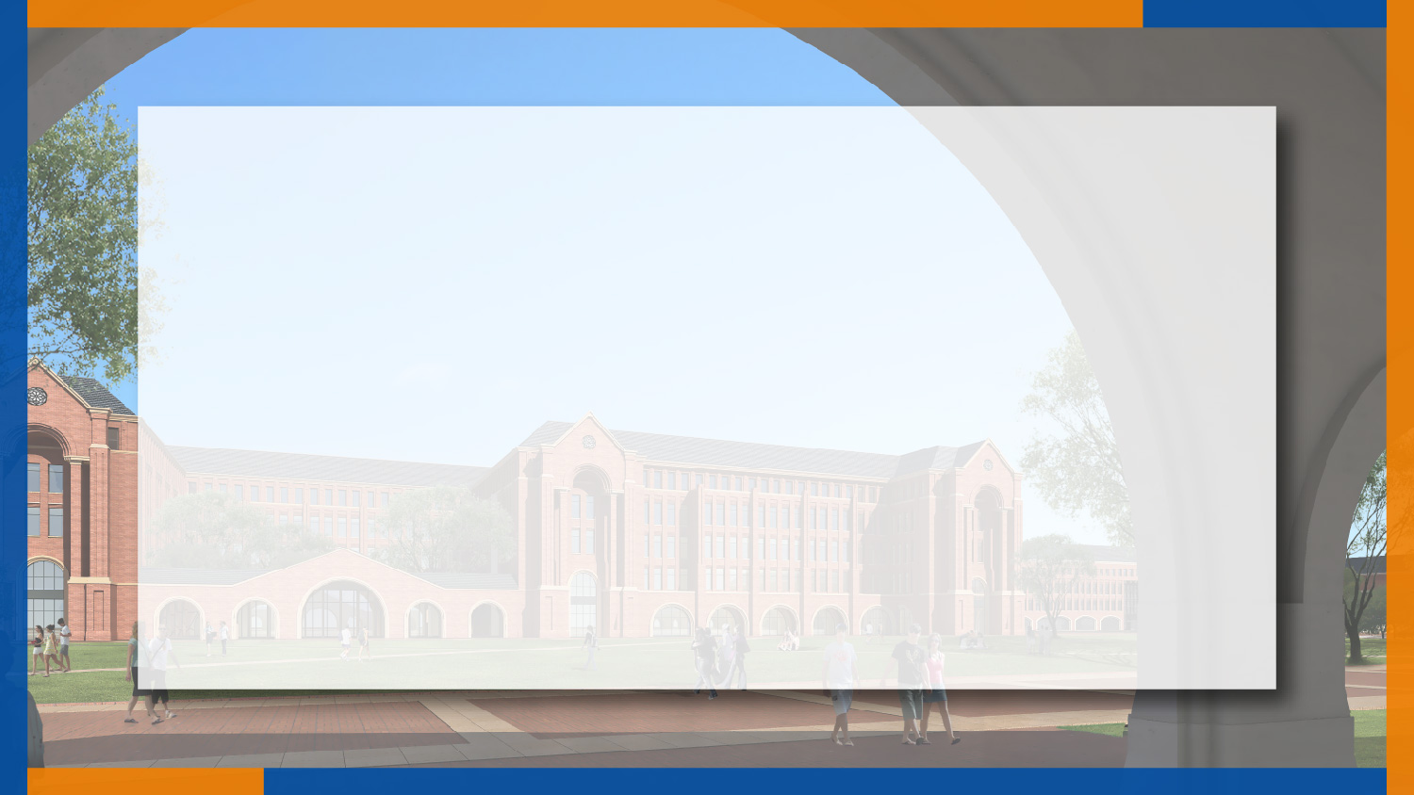

ECE445
Mimicry Stage Lighting Control System
Team #29
RUIQI LI - ECE
HAOZHE CHEN - ECE
ZHAOHUA YANG - EE
ANQI TAN - ME
Sponsor: Timothy Lee
March 25, 2022
Notes:
Good morning everyone. Our project is called mimicry stage lighting control system. This is Haozhe chen…… And many thanks to our sponsor Professor Lee.

Slide 2
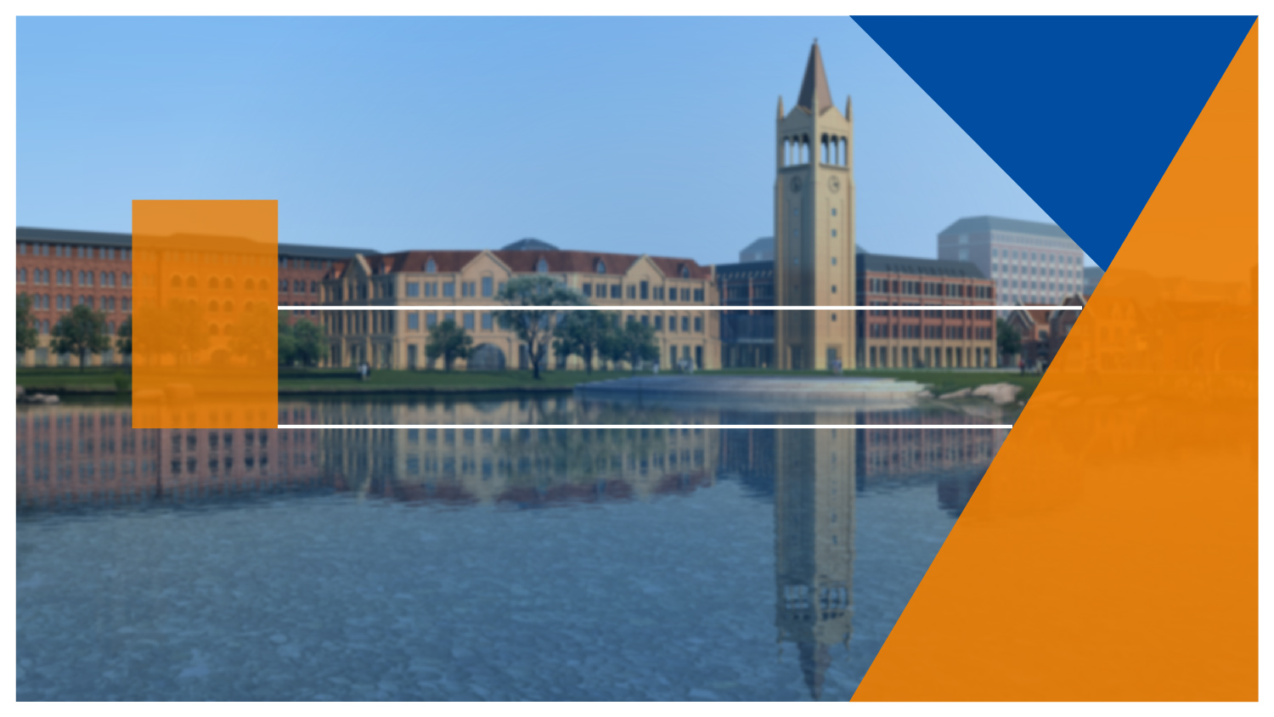

1
Introduction

Slide 3
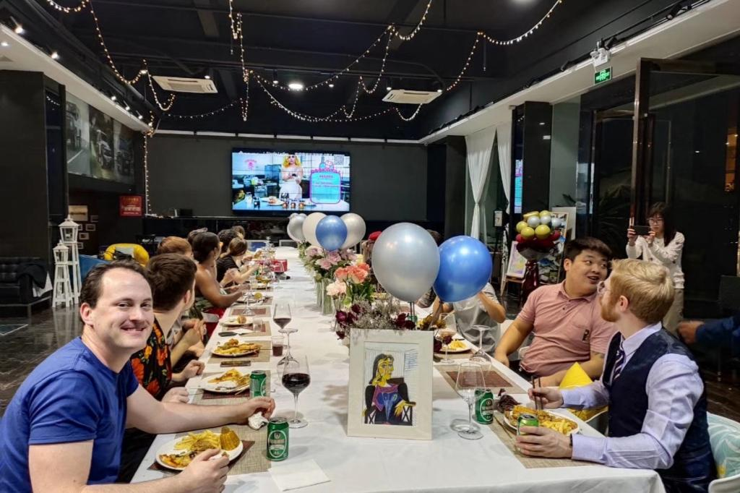
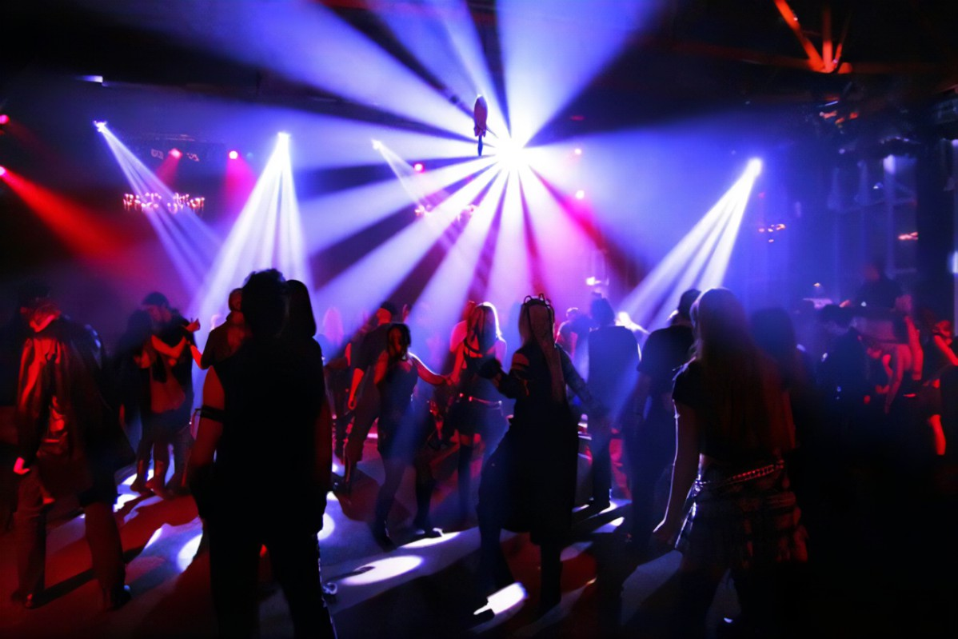
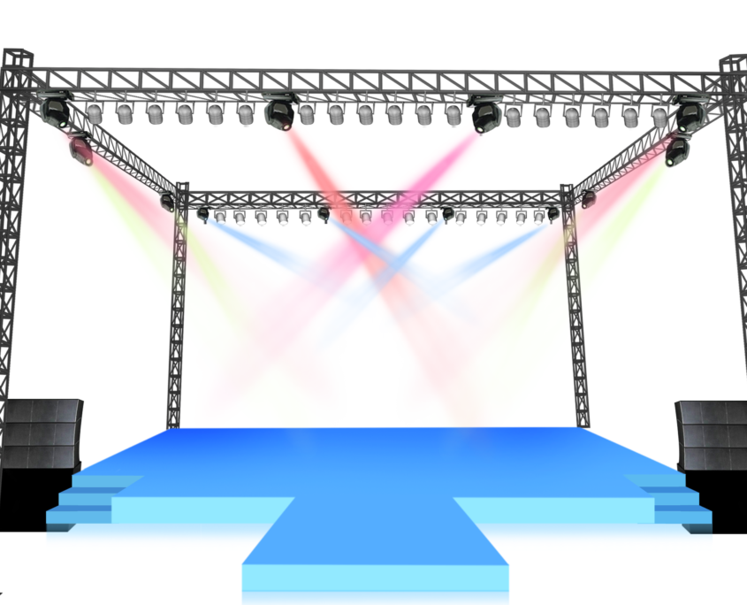
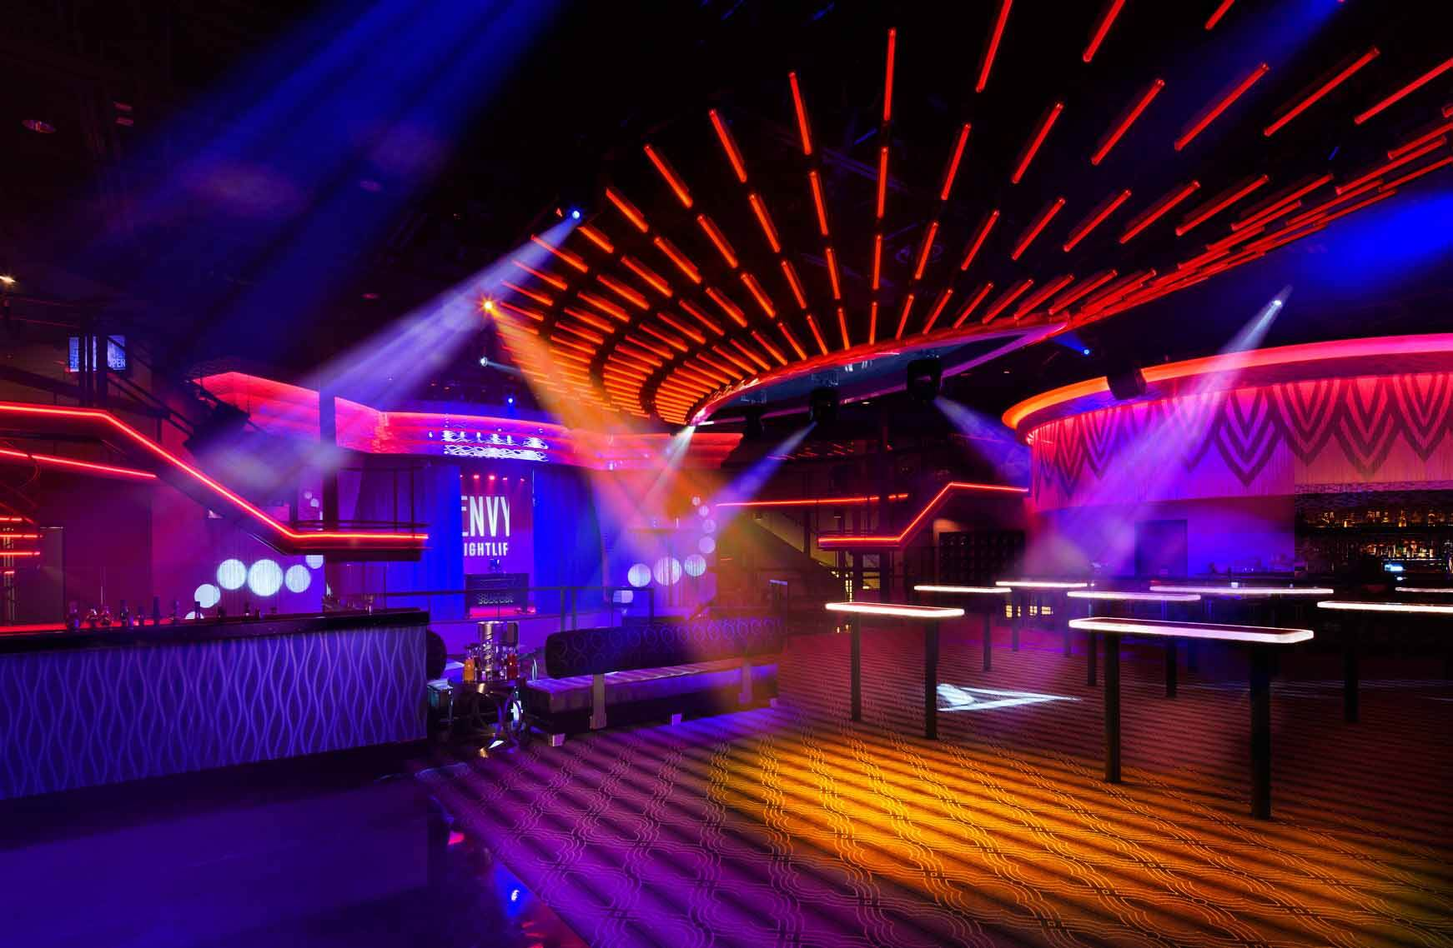
What is Stage Lighting System (SLS)?
Notes:
Stage lighting system is such a system to perform artistic lighting on large stages to achieve specific effects. However, under some smaller and amateur circumstances, like home parties, small bars or discos, a complete SLS may encounter some problems.

Slide 4
What is the Problems under Smaller and Amateur Circumstances?
It’s too Unwieldy
It’s difficult to operate
It lacks liveness
Notes:
First, It's too unwieldy. A complete SLS consists of lanterns, cables, dimmers, and a control desk. It is cumbersome for smaller scenarios.
Second, It's difficult to operate. An SLS needs professional stage lighting engineers to install and operate.
Third It lacks liveness. In real practice, live manipulation and improvisation are unavoidable. DJs and performers may want a direct control power to the light.

Slide 5
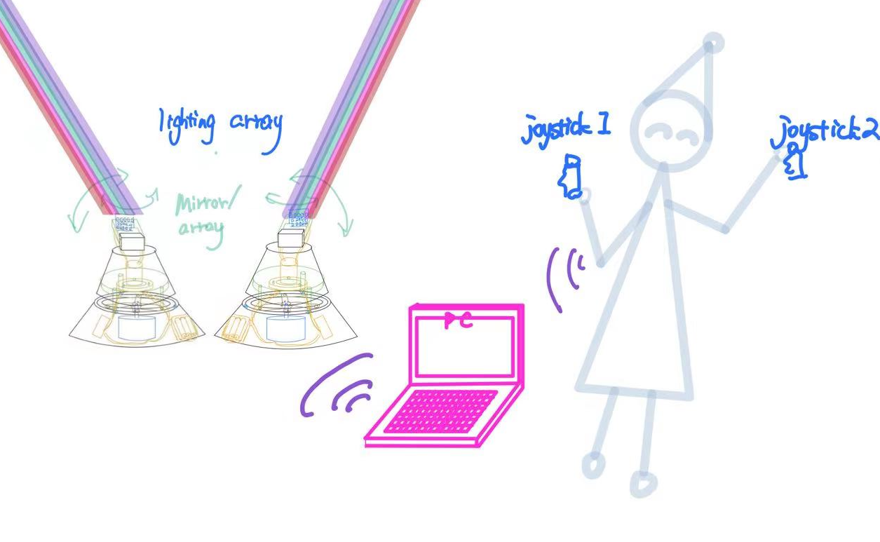
Solution: Mimicry Stage Lighting Ccontrol System
Notes:
The solution of these problems would be: Mimicry stage lighting control system. An operator holds a joystick in each hand. The joysticks track the movement of each arm and transmit the direction signal to the central server. This signal is then processed and redirected to the portable light arrays to control the actual direction of lights. The color of light can be determined automatically according to the feature of music.

Slide 6
High-level Requirements
Precision
Spatially, the precision of direction: ±10°
Temporally, low latency: ≤100ms
Portability
Easy to carry: 40L backpack, ≤10kg
User-friendliness
Easy to use: operator can use it intuitively; low complexity of music analysis
Notes:
There are several high level requirements we need to meet. First, for a good stage effect, the direction should be precise enough. In our case, the difference should be less than 10 degrees. Temporally, the precision means low latency. The delay between the operator and the lights should be less than 100 millisecond.
Second, the whole gadgets should be easy to carry. The minimum configuration should be able to be contained in a 40L backpack and less than 10 kg. All devices should be charged by batteries. Moreover, at least 60 minutes of endurance should be guaranteed.
Third, it should be easy to use. The user should be able to control the direction of lights intuitively. The color of light should be automatically encoded and the music analysis algorithm should have a low complexity.

Slide 7
2
Design

Slide 8
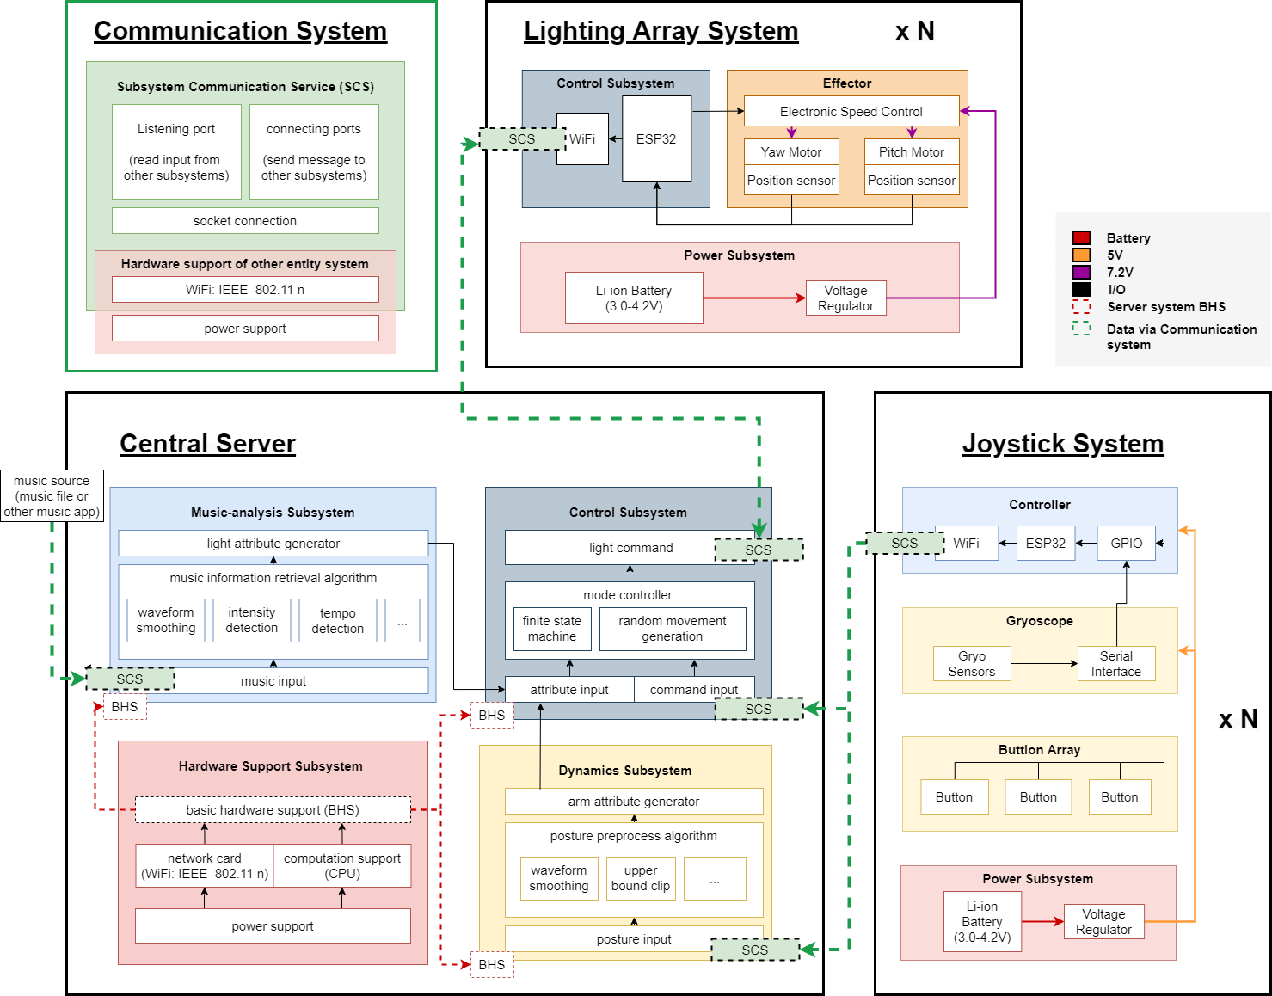
Block Diagram
Three main physical device type and an abstract communication system.
Communication system
Lighting array system
Joystick system
Central server
Music Analysis Subsystem
Dynamic Subsystem
Control Subsystem
Notes:
Now let me introduce the design of our project.
As shown in the block diagram, our mimicry stage lighting system mainly consists of three physical device type, the Lighting array system, the Joystick system and a central server. and an abstract communication system.
First, let me introduce the communication system. This is a software system that been abstracted from each device to simplify the communication process. The green dashed line on the diagram mean the message sent via this system.

Slide 9
Communication System
An abstract software system that connects all the device.
The hardware part is supported by the host device:
Continuous power supply
Network card support 802.11n IEEE WLAN standard
(Known as WiFi)
Notes:
Let focus on detail of this system.
The hardware of this system is support by each host device. And those hardware should ensure the continuous power supply and support 802.11n IEEE standard, which in the known as WiFi in common sense.
(4n, 5ac, 6ax)

Slide 10
Communication System
An abstract software system that connects all the device.
The software part are built with socket communication protocol.
TCP for ensuring the stable and safety of connection.
NTP used for timestamp synchronization. (auto)
Launch a service for communication:
Listening port: receives message and delivers to high-level application.
Connect port: connect to other device and send message.
Notes:
With the hardware infrastructure, software is able to developed and executed. Socket communication protocol is used to declare the target program ports and TCP connection will be established to ensure the stability and safety.
NTP, the network time protocol, is automatically used in TCP to synchronize timestamp between devices.
Then a communication service will be started for all devices. The listening port is used to receive message and redirect to high-level application. Other ports are kept available to establish connection with other systems.

Slide 11
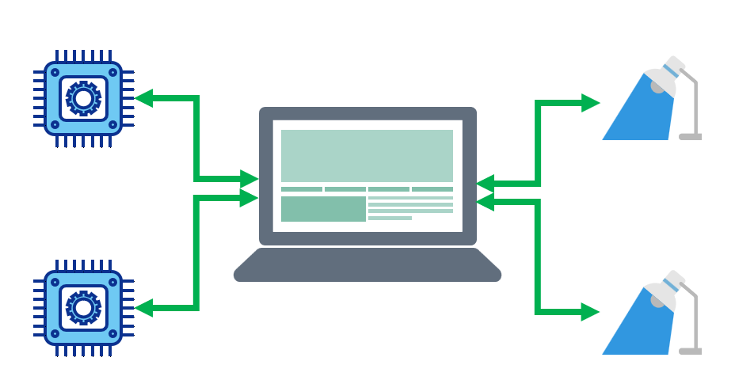
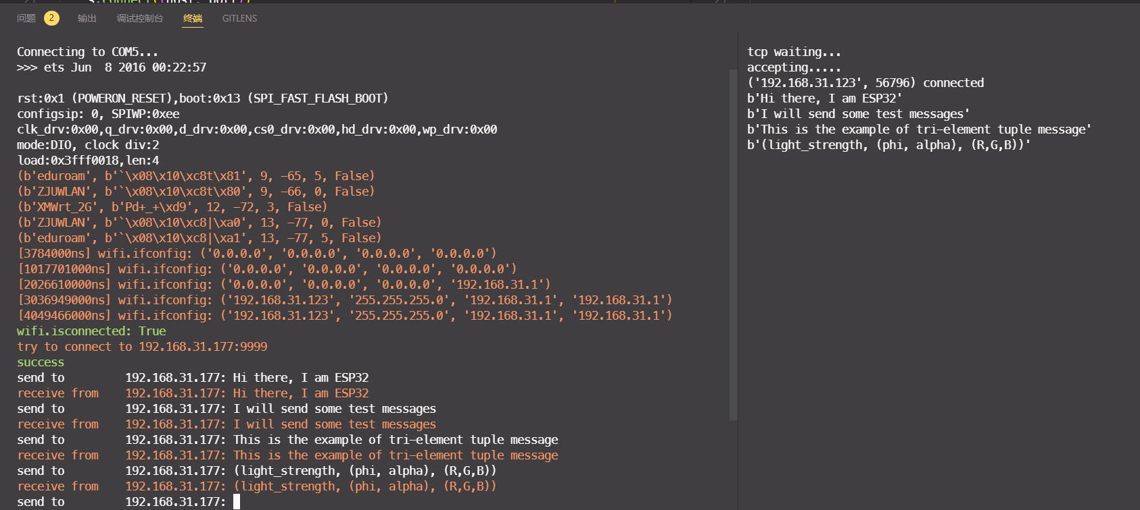
Communication System
Topology
4
1
2
3
Notes:
This figure shown the topology under this communication system.

Slide 12
Lighting Array
Control subsystem:
Though commuication system
Get the angle requirment information
ESP32
The angle information required by Yaw axis and Pitch axis will be analyzed into PWM signal to control motor rotation.
Compare real-time location information with the angle requirment and update instructions to close the gap.
Realize PID closed-loop control
Notes:
##Lag _ catch
###Lead _Low down
Now, Let’s move on to the lighting array system.
The control subsystem get the angle requirement information form the communication system. The ESP32 use PWM signal to control motor rotation. And use the real-time location information to realize the PID control. If the robot arm moving lag behand the human arm, then the motor will try to catch up. And if the robot arm lead time, the motor should low down.

Slide 13
Lighting Array
Power subsystem:
Voltage Regulator
Transformer step-down
Battery
4.2 1650 Li-ion Battery *N (array)
Notes:
As the power subsytem also exists in other system, my teammate will mention this part later.

Slide 14
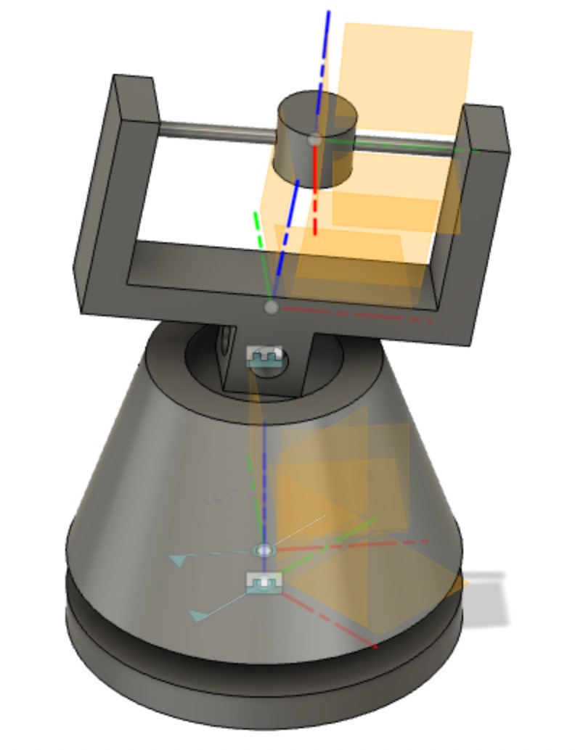
Lighting Array
Pitch - Servo
Yaw - Brushless DC motor
Both motors can provide position return
Notes:
For the Effector subsystem, we have a really casual CAD model
This is our pitch and yaw movement.
####The pitch axis will control by servo, and the yaw axis moving by the Brushless DC motor
Both kind of motors can provide position return

Slide 15
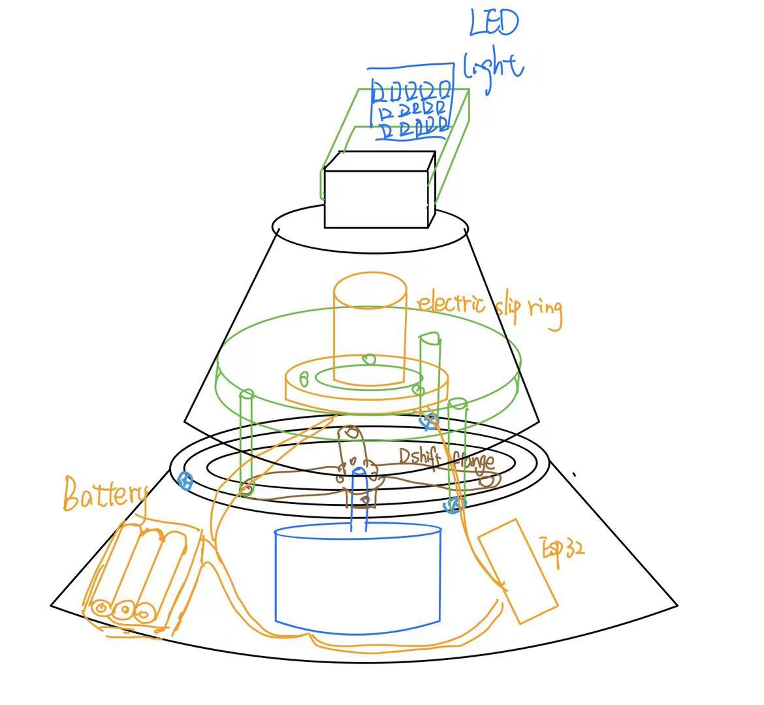
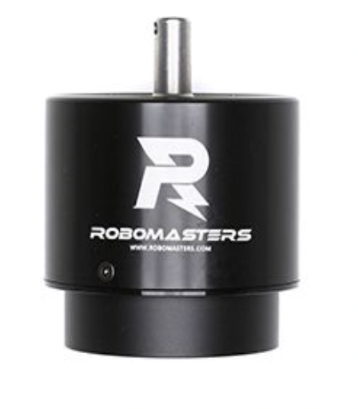
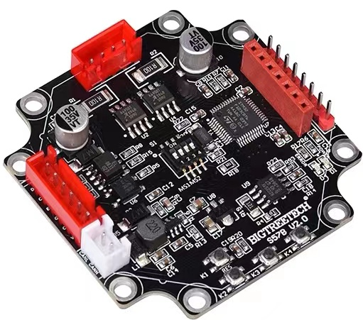
Lighting Array
GM6623 gimbal motor
Controller Inside
GM6623 gimbal motor
Motor built-in position sensor, through CAN bus can get rotor position, rotor speed, motor temperature and other information
The driving shaft can absorb larger forces
Notes:
This is the detail sketch.
GM6623 gimbal motor as our motor for yaw shift, which has Controller Inside
Motor built-in position sensor, through CAN bus can get rotor position, rotor speed, motor temperature and other information
And also
The driving shaft can absorb larger forces around 100kN
…
That’s why we do not use the gear belt-structure in our design, which makes the mechanical structure more compact.

Slide 16
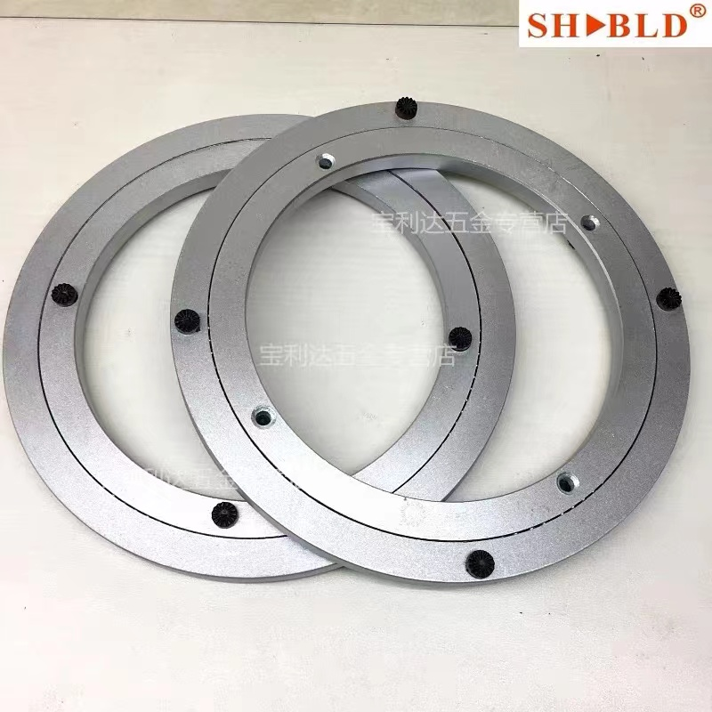
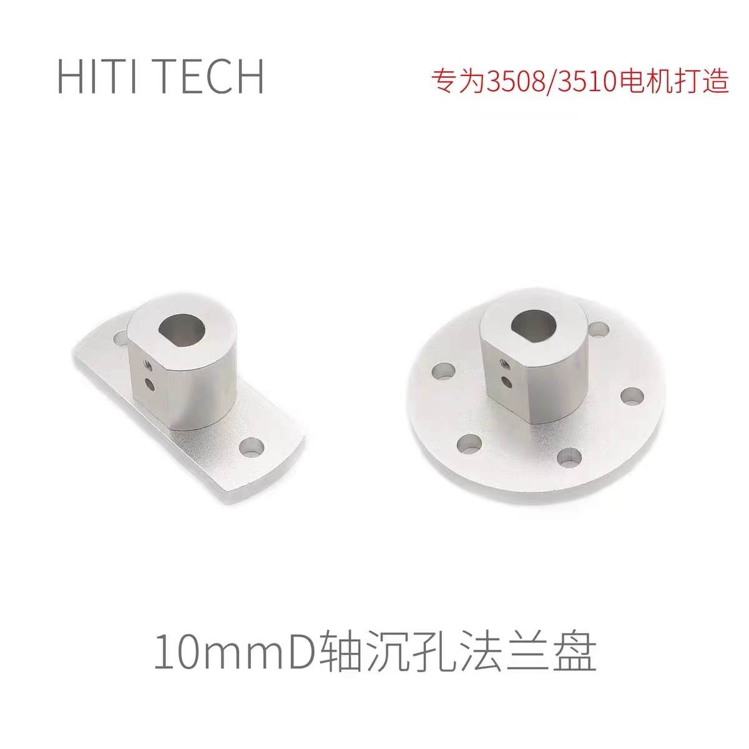
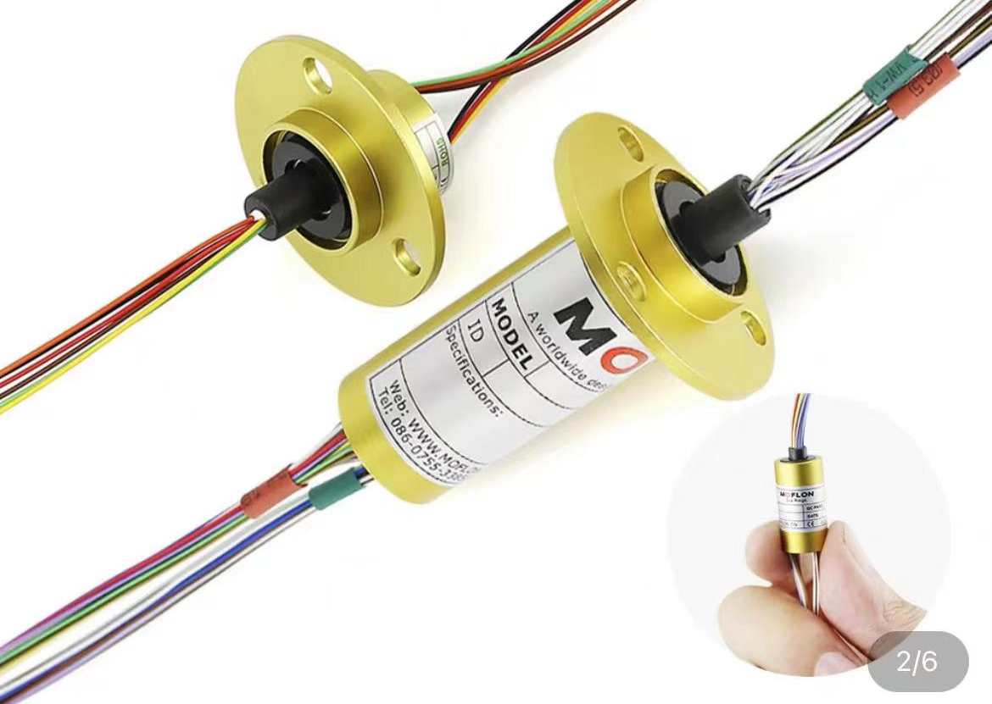
Lighting Array
Crossed roller bearing
& Flange
&Eletric slip ring
Notes:
交叉滚子轴承(变长)
The
Crossed roller bearing
&Flange [flændʒ]
&Eletric slip ring
分别确保了力的承接和走线
Respectively to ensure the force to undertake and line connection.

Slide 17
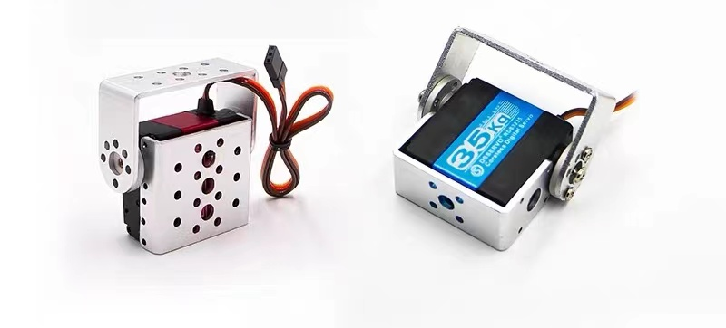
Lighting Array
Dsservo Servo 360°
Digital servo – High accuracy
The servo control board inside is controlled by MCU --High stability
Given PWM pulse width at one time –Low latency
Notes:
Servo来控制pitch 轴的运动
The servo we choose to control the pitch can give us Higher accuracy, higher stability and lower. latency

Slide 18
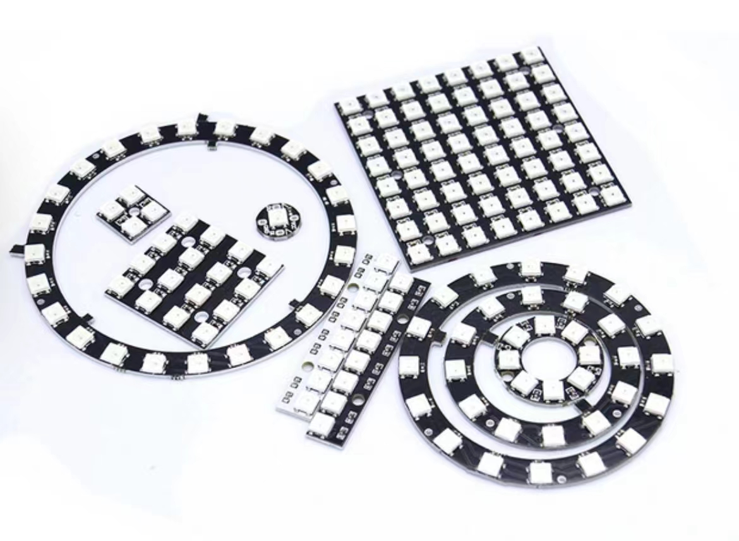
Lighting Array
LED ws2812 RGB development borad
Receives RGB signals from the control center
The three primary colors of each pixel can achieve 256 levels of brightness display
Built-in signal shaping circuit ensures no distortion accumulation
Notes:
The LED borad
…Receives RGB signals from the control center
…The three primary colors of each pixel can achieve 256 levels of brightness display
And also the Built-in signal shaping circuit ensures no distortion accumulation
.. [ˈsɜːkɪt] [dɪˈstɔːʃn]

Slide 19
Joystick System
The Joystick Subsystem consists of Controller (ESP32), Gyroscope (MPU6050), Button Array, and Power Subsystem.
Power Subsystem: empower ESP32, but need to make sure the voltage is stable.

Slide 20
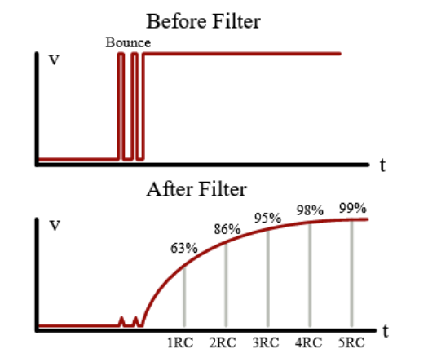
Joystick System
Button Array: The open or close determines the mode of our robot arm. For example, when the robot arms are

Slide 21
Joystick System
Gyroscope: Get the X, Y, Z coordinates and store them into a specific address of I2C bus to ESP32.

Slide 22
Joystick System
Controller: Send data to dynamic subsystem via WIFI. Read constantly from the assigned address where MPU6050 stores its value via I2C bus.

Slide 23
Central Server
A central computation platform that handle all the computational heavy process
Hardware Support Subsystem
Power support
Network card support 802.11n IEEE WLAN standard
(Known as WiFi)
Music Analysis Subsystem
Dynamic Subsystem
Control Subsystem
Notes:
The central server subsystem is an abstract system that connects all the devices. This contains three software subsystems and a hardware support subsystem. The hardware support subsystem is the basic of all our project, containing parts like power support, network card support. The software subsystems are services running on the central server. The central server is a PC. Now let’s introduce these services.

Slide 24
Music Analysis Subsystem
An Software Service that Generates Light Color Sequence
This service is implemented using Python, involving basic signal process and music information retrieval.
The algorithm maps the latent information of the music to the color sequence of the lights
Notes:
The music analysis system is a service running on the central server to generate light color sequence. The algorithm is implemented using Python, involving basic signal process and music information retrieval. Basically, this algorithm maps the latent information of the music to the color sequence of the lights.

Slide 25
Music Analysis Subsystem
An Software Service that Generates Light Color Sequence
The music input is sampled at 22050Hz.
Notes:
The music input can have all kinds of sources, like downloading it from an app. It is then sampled at a certain sample rate.

Slide 26
Music Analysis Subsystem
An Software Service that Generates Light Color Sequence
The music input is sampled at 22050Hz.
Music Feature Analysis
Notes:
The algorithm can be divided into two parts: analysis and synthesis. The analysis part extracts features from the original waveform, like tempo detection

Slide 27
Music Analysis Subsystem
An Software Service that Generates Light Color Sequence
The music input is sampled at 22050Hz.
Music Feature Analysis
Tempo detection / Beat tracking

Slide 28
Music Analysis Subsystem
An Software Service that Generates Light Color Sequence
The music input is sampled at 22050Hz.
Music Feature Analysis
Tempo detection / Beat tracking
Intensity detection
Notes:
Intensity detection

Slide 29
Music Analysis Subsystem
An Software Service that Generates Light Color Sequence
The music input is sampled at 22050Hz.
Music Feature Analysis
Tempo detection / Beat tracking
Intensity detection
Waveform smoothing / filtering
Notes:
And waveform filtering

Slide 30
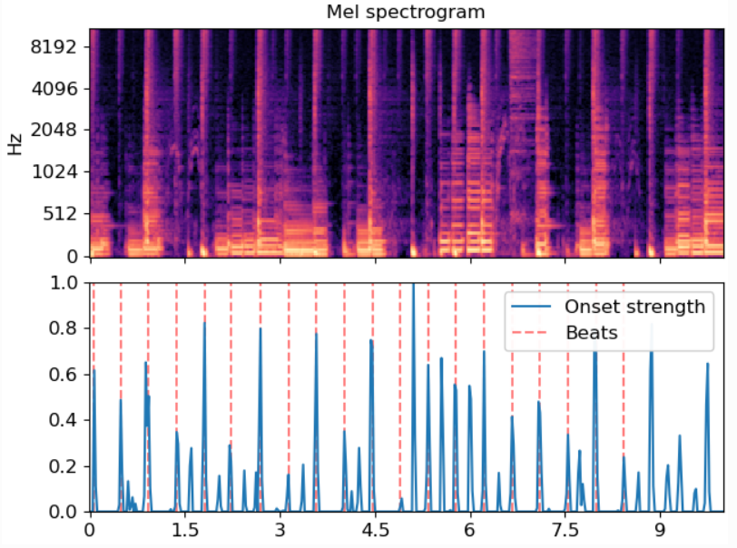
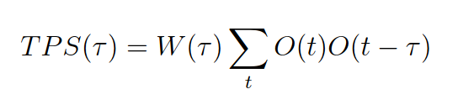
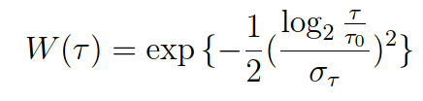
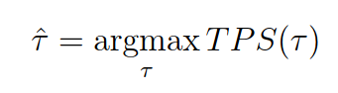
Music Analysis Subsystem
An Software Service that Generates Light Color Sequence
The music input is sampled at 22050Hz.
Music Feature Analysis
Tempo detection / Beat tracking
Intensity detection
Waveform smoothing / filtering
Notes:
A preliminary experimental result can be shown here. Onset strength indicates the probability of being a beat. The red lines are final beats predicted. The global tempo can also be determined this way.

Slide 31
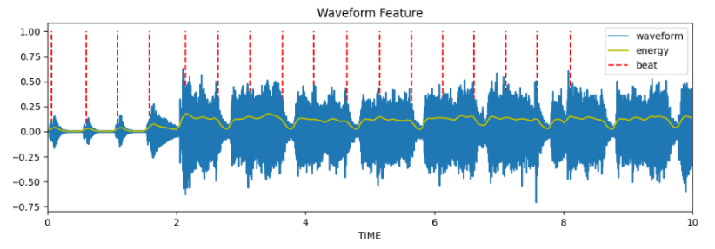
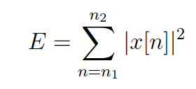
Music Analysis Subsystem
An Software Service that Generates Light Color Sequence
The music input is sampled at 22050Hz.
Music Feature Analysis
Tempo detection / Beat tracking
Intensity detection
Waveform smoothing / filtering
Notes:
This shows the curve of intensity. The yellow line means the energy curve. We simply use Parseval’s Theorem to compute the root-mean-square values.

Slide 32
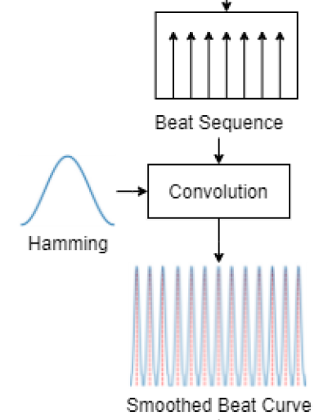
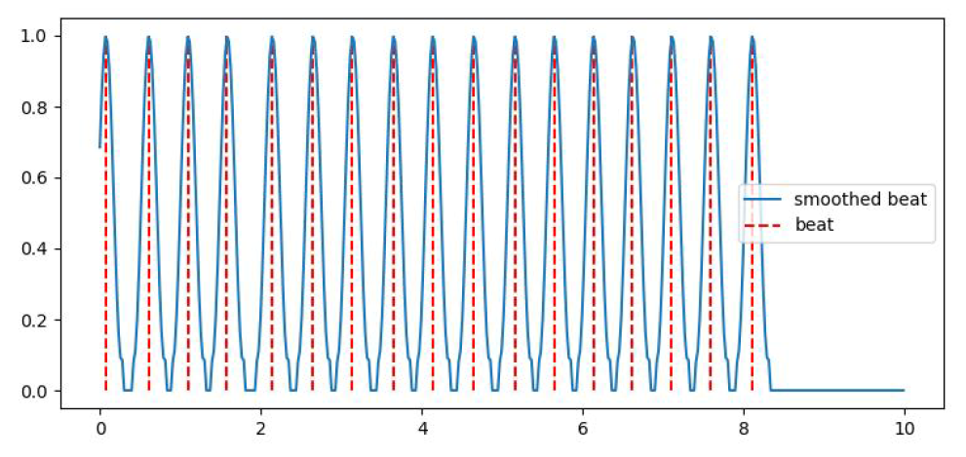
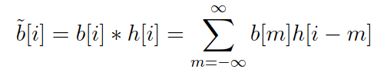
Music Analysis Subsystem
An Software Service that Generates Light Color Sequence
The music input is sampled at 22050Hz.
Music Feature Analysis
Tempo detection / Beat tracking
Intensity detection
Waveform smoothing / filtering
Notes:
To make the effect of beat sequence smoother, we compute the convolution between the beat sequence and a Hamming window.

Slide 33
Music Analysis Subsystem
An Software Service that Generates Light Color Sequence
The music input is sampled at 22050Hz.
Music Feature Analysis
Tempo detection / Beat tracking
Intensity detection
Waveform smoothing / filtering
Color Sequence Synthesis
Heuristic Formula
Notes:
After analysis, we feed these features into the Synthesis part.

Slide 34
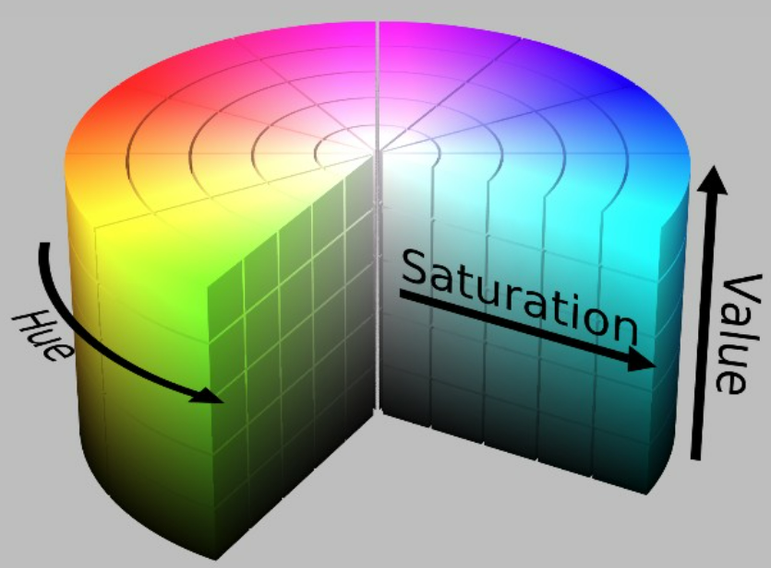
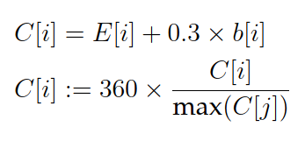
Music Analysis Subsystem
An Software Service that Generates Light Color Sequence
The music input is sampled at 22050Hz.
Music Feature Analysis
Tempo detection / Beat tracking
Intensity detection
Waveform smoothing / filtering
Color Sequence Synthesis
Heuristic Formula
HSV model: hue(0~360°)
Notes:
We use HSV model as our color model. In this model, hue value is ranged from 0 to 360 degrees, which can be mapped to RGB values. The HSV value is therefore heuristically determined by this formula, which combines the energy of the song and the impact of beat sequence.

Slide 35
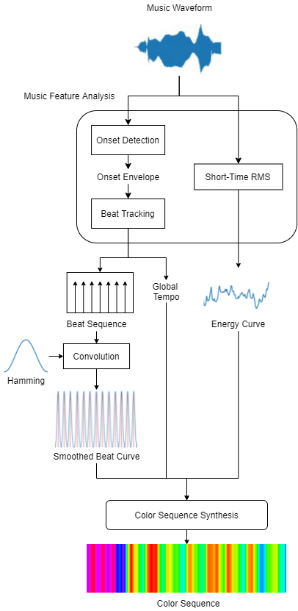
Music Analysis Subsystem
An Software Service that Generates Light Color Sequence
The music input is sampled at 22050Hz.
Music Feature Analysis
Tempo detection / Beat tracking
Intensity detection
Waveform smoothing / filtering
Color Sequence Synthesis
Heuristic Formula
Notes:
The flowchart of the algorithm is shown here. As you can see, analysis and synthesis.

Slide 36
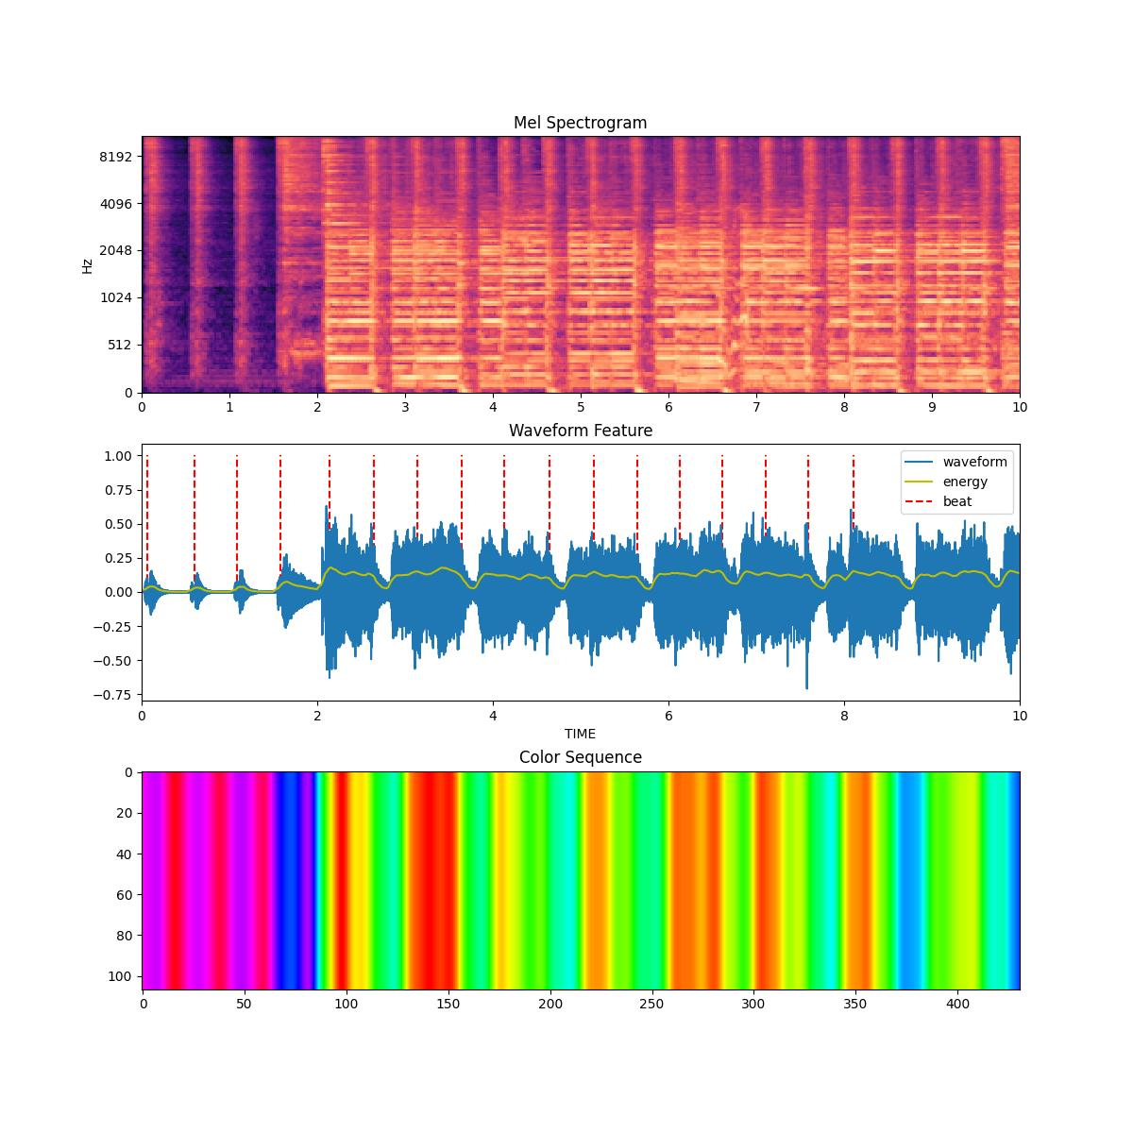
Music Analysis Subsystem
An Software Service that Generates Light Color Sequence
The music input is sampled at 22050Hz.
Music Feature Analysis
Tempo detection / Beat tracking
Intensity detection
Waveform smoothing / filtering
Color Sequence Synthesis
Heuristic Formula
Notes:
A preliminary result is shown here. It’s worth mentioning that this formula is highly personalized, so there is still a lot of room for improvement.

Slide 37
Central Server
A central computation platform that handle all the computational heavy process
Hardware Support Subsystem
Power support
Network card support 802.11n IEEE WLAN standard
(Known as WiFi)
Music Analysis Subsystem
Dynamic Subsystem
Control Subsystem
Notes:
Let me introduce the second subsystem of the central server, the dynamics subsystem

Slide 38
Dynamics Subsystem
Receive posture data from joystick system via communication system.
{...},
{...},
{
"timestamp": 1648145593.9729125,
"x":120,
"y":120,
"z":120
},
{...},
{...},
{...},
Notes:
This subsystem act as the preprocessor of the joystick system’s posture data. The data with the such format will be received via communication system, which including the timestamp and 3D posture data.

Slide 39
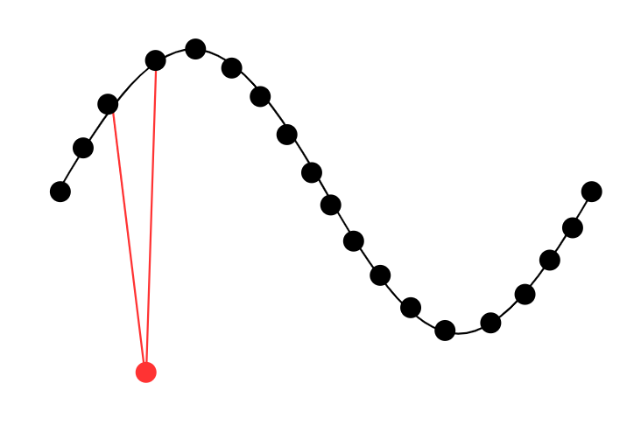
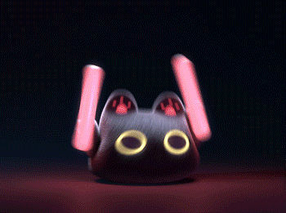
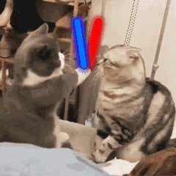
Dynamics Subsystem
The accident in communication may cause lost package or wrong data. Aroused DJ may also wave the joystick too quick for the sensor to detect and for the arm to follow.
✔️
❌
Missing or wrong data point may cause unpredictable behavior of lighting array.
Kalman filter algorithm is used for smoothing the waveform.
Notes:
Although communication system tries best to maintain reliable connection~, accident happens.
The accident in communication may cause lost package or wrong data. Aroused DJ may also waves the joystick too quick for the sensor to detect and for the arm to follow.
(click)
Missing or wrong data point may cause unpredictable behavior of lighting array.
Therefore, Kalman filter algorithm is used for smoothing the waveform.

Slide 40
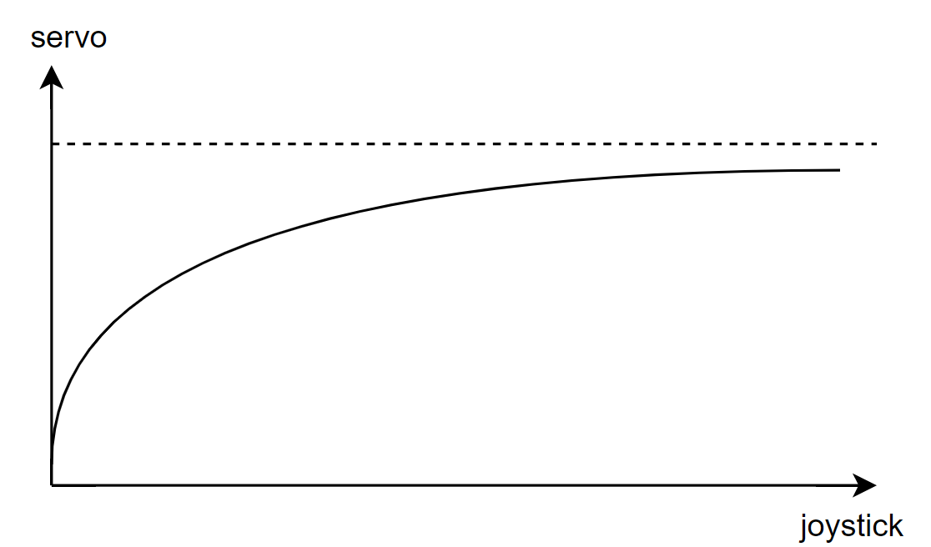
Dynamics Subsystem
The workspace (range of reachable space of arm) is limited by the physical structure.
Certain unreachable angle range beyond the upper bound will be clipped.
Notes:
It also should be mentioned that human can direct the joystick to any angle, while the workspace of robot arm is limited by the physical structure.
Certain unreachable angle range beyond the upper bound will be clipped.

Slide 41
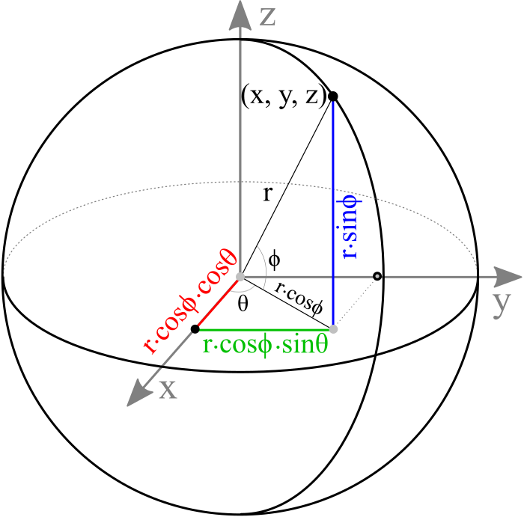
Dynamics Subsystem
The posture data received from joystick is three dimensional.
While the 2 DOF arm of light should receive 2-element control command.
Remap from 3D to 2D, considering the radius distance fixed.
Notes:
Finally, and is also the core function of this subsystem, remapping.
In the last step, the subsystem convert the 3D posture data to 2D movement command for controlling the robot arm of lighting array.

Slide 42
Central Server
A central computation platform that handle all the computational heavy process
Hardware Support Subsystem
Power support
Network card support 802.11n IEEE WLAN standard
(Known as WiFi)
Music Analysis Subsystem
Dynamic Subsystem
Control Subsystem
Notes:
Ok, it’s time to move back to the final part of the design, the control subsystem.

Slide 43
Control Subsystem
Works as a mode controller and a combinator of control frame.
Music
Light color
Light movement
Control frame
Notes:
The control subsystem works as a mode controller and a combinator of control frame. A control frame consist of period of music source file, sequence of light color and movement command. It allows the light moves as music play and stop as music stop.

Slide 44
Control Subsystem
Works as a mode controller and a combinator of control frame.
Receives:
Generated light color command from music analysis subsystem
Light movement command from dynamic subsystem
Button command data from joystick system
Notes:
In the first step,
The control subsystem receives generated light color command from music analysis subsystem,
light movement command from dynamic subsystem,
And button command data from joystick system
The former two data commands are used as candidate raw commands and the latter will be used for mode selection.

Slide 45
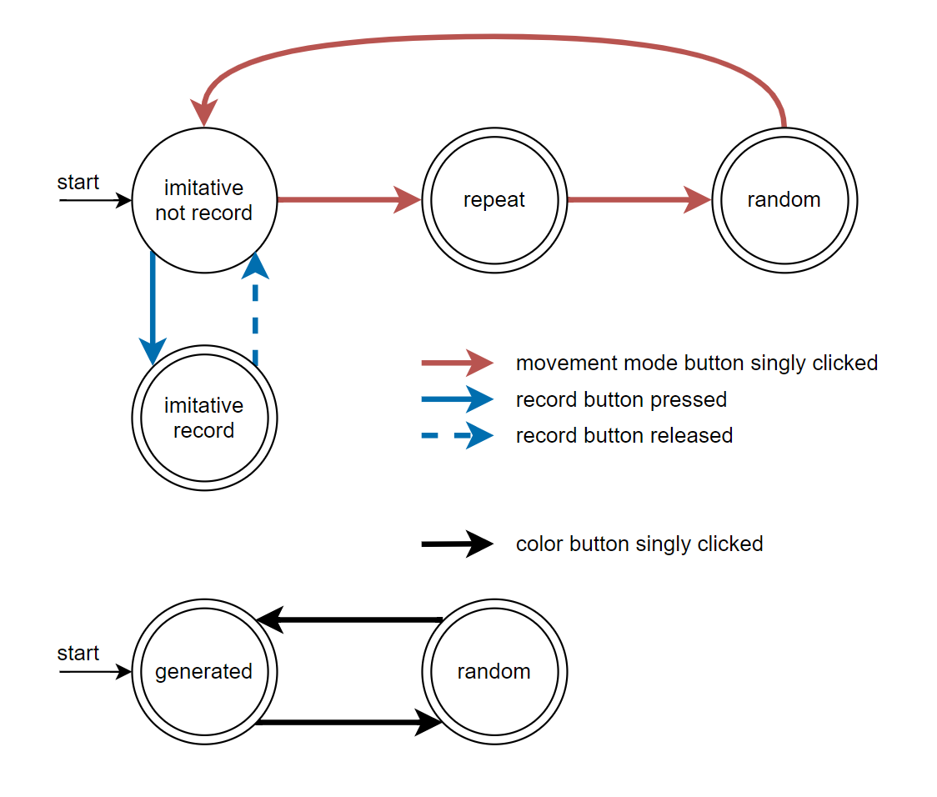
Control Subsystem
Works as a mode controller and a combinator of control frame.
Random color and movement will be generated by the random generator, used for random mode
The light color mode and movement mode are controlled by finite state machines.
Notes:
Another candidate command data is generated by the random generator, for both color and movement. Those two set of command will be filtered by finite state machine separately.
(click)
As you can see. There are three mode for movement and two mode for color.
By clicking the movement mode button on joystick, the movement mode will switch in order of imitative, repeat and random. If you are in the imitative mode, you can record the posture sequence by press the record button and replay it during the repeat mode.
The light color mode can be chosen in the similar way.

Slide 46
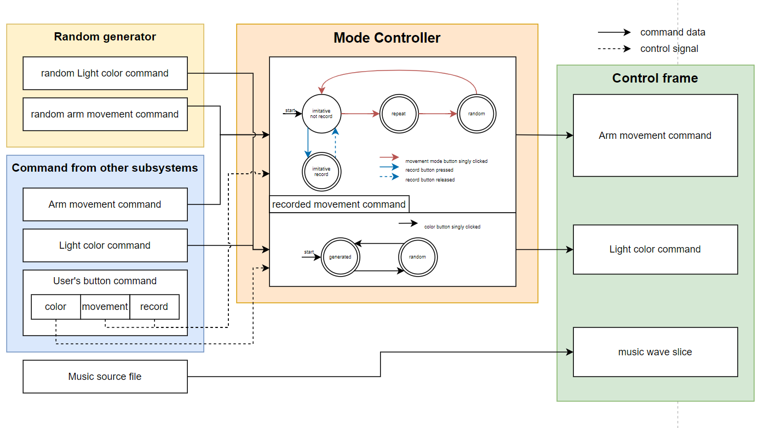
Control Subsystem
Works as a mode controller and a combinator of control frame.
The finite state play a role of command filter.
Random or processed command data is combined to a control frame.
Notes:
The finite state machine plays a role of command filter. For each control frame, one of the random or processed command will be combined. Just like it shows on the diagram.

Slide 47
3
Tolerance Analysis

Slide 48
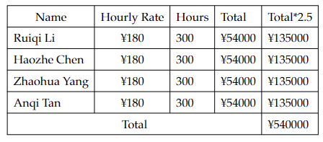
Labor

Slide 49
Tolerance Analysis
The workspace of the robot arm may be limited. It’s acceptable if the reachable angle meets the stage/room’s coverage
Because of the singularity, the robot arm may be stuck. It’s acceptable if some workspace is sacrificed but the singularity is prevented
……
Notes:
30s
As the time limit, for the tolerance analysis, we just talk about some examples of the mechanical part,
Due to the existence of the base and its lack of freedom, the reachable angle of the two-axis robot arm of this product is smaller than that of the real human arm.
The acceptable result is that the workspace of the manipulator meets the stage/room lighting coverage.
At the same time, because of the singularity of the mechanical arm, the mechanical arm may be stuck after reaching a certain angle and unable to move, thus leading to product damage.
An acceptable result is to avoid the attitude of the manipulator entering the singularity by setting up a specific mechanical protection structure.

Slide 50
4
Cost and Schedule

Slide 51
Labor

Slide 52
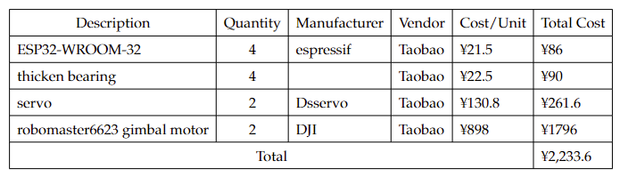
Parts

Slide 53
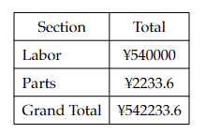
Grand Total

Slide 54
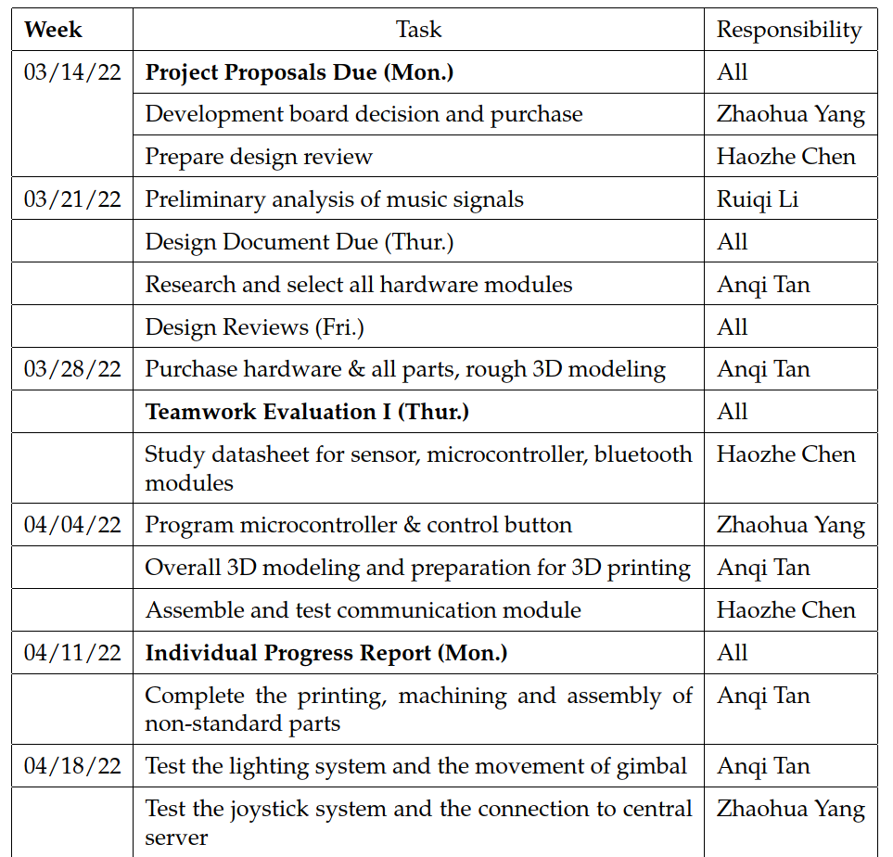
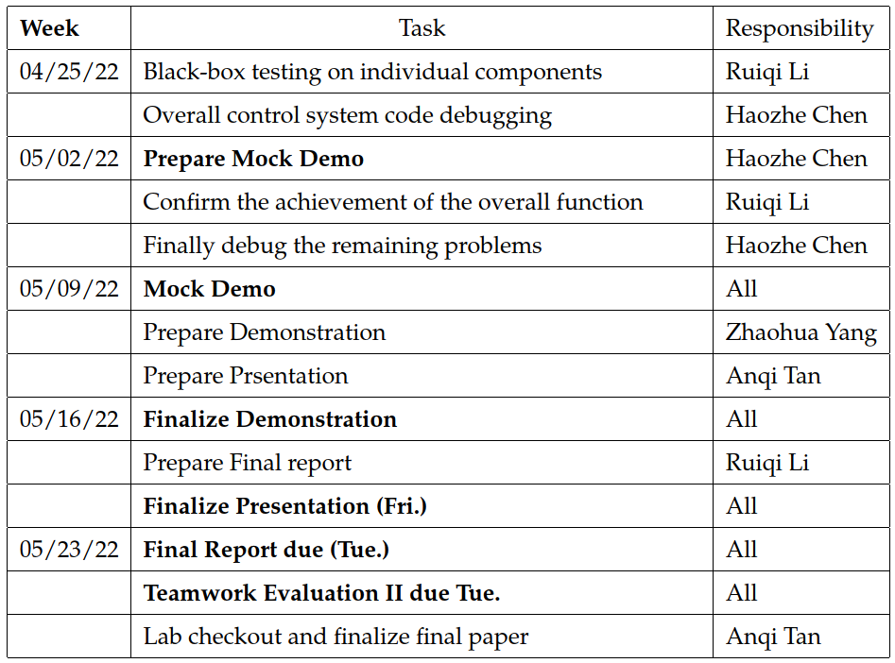
Schedule

Slide 55
5
Ethics and Safety

Slide 56
Ethics
Safety
Ethics of our product
Ethics of research and development
- No capy
- No plagiarism
- No existing solution
Ethics sources
- This project is bound and inspired by the Code of Ethics published by professional societies, such as IEEE and ACM.
Production safety
Electricity safety
Mechanical structure safety
Material processing safety

Slide 57
Thanks for your listening

Slide 58
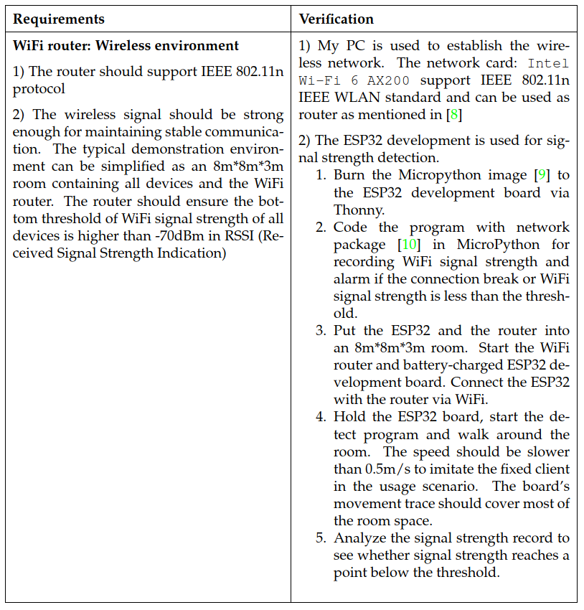
Requirements and Verification – Communication Subsystem
Notes:
Requirements and Verification – Communication Subsystem

Slide 59
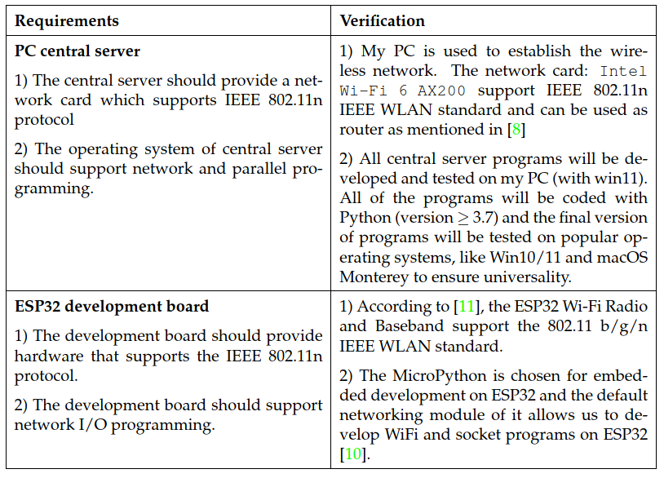
Requirements and Verification – Communication Subsystem
Notes:
Requirements and Verification – Communication Subsystem

Slide 60
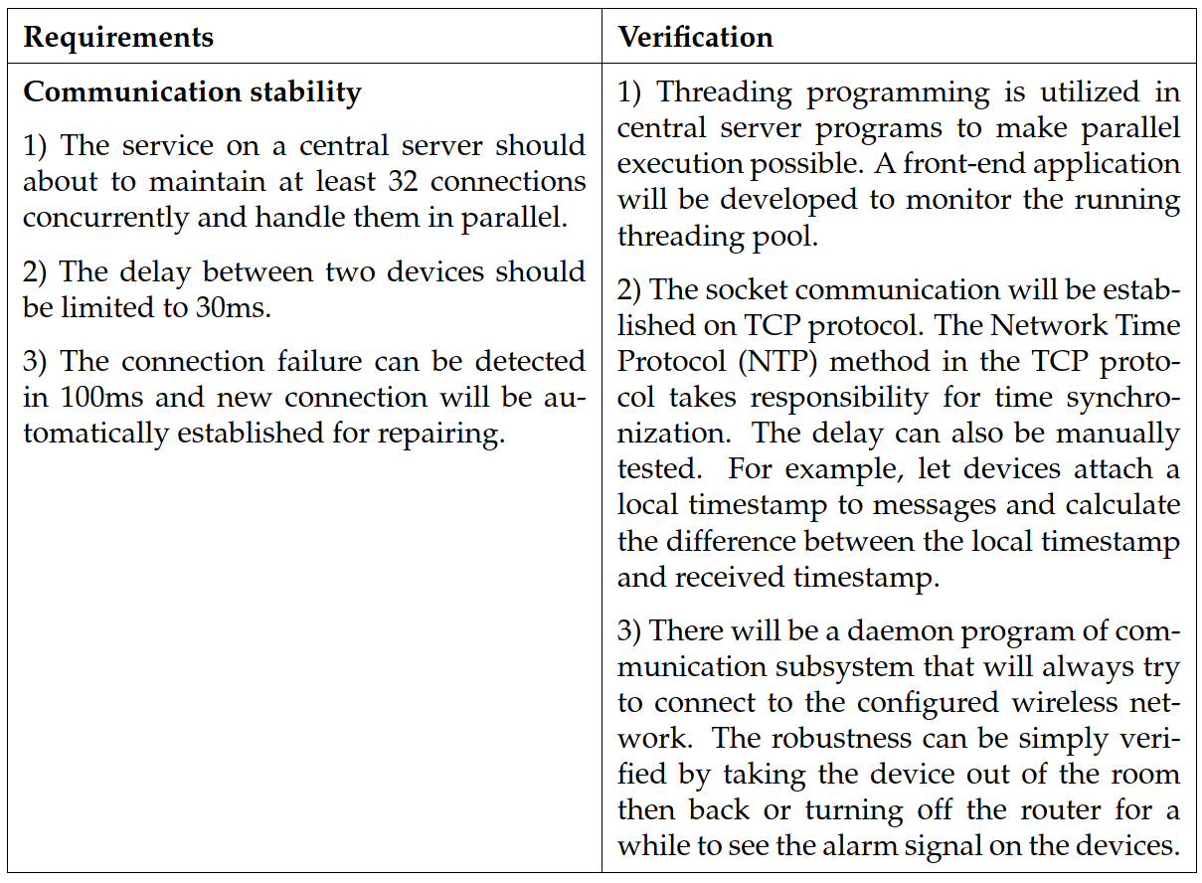
Requirements and Verification – Communication Subsystem
Notes:
Requirements and Verification – Communication Subsystem

Slide 61
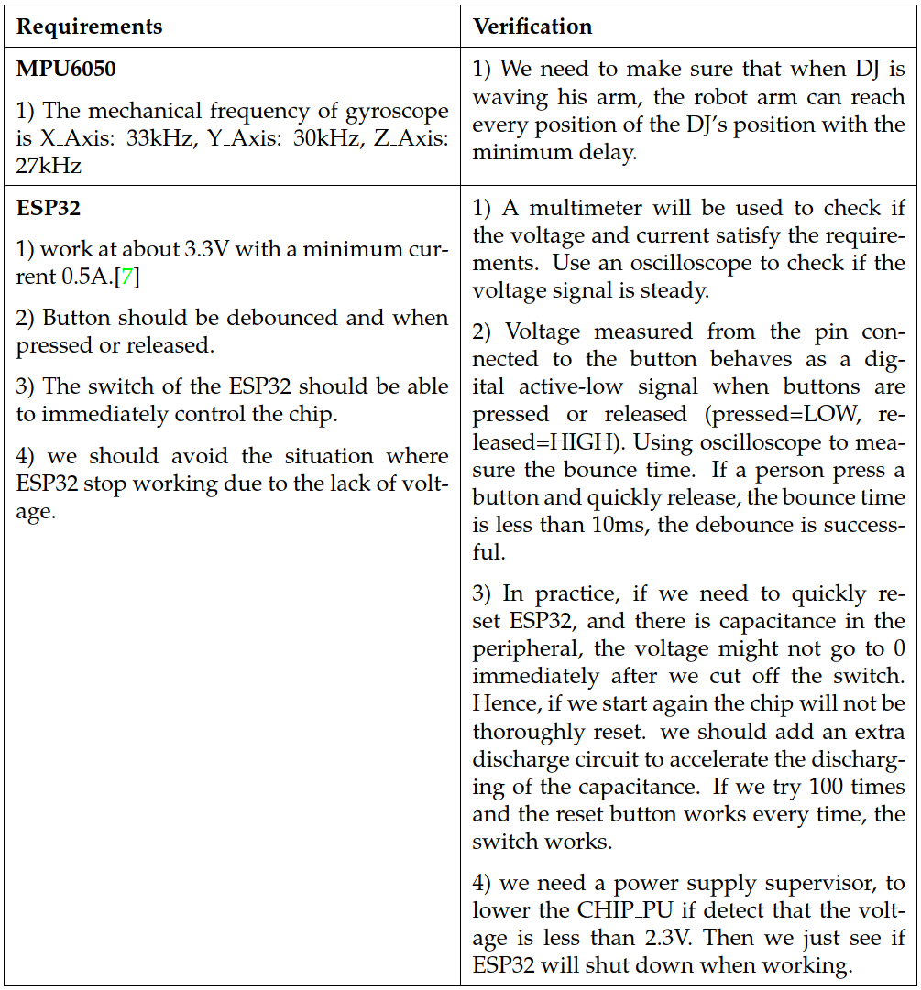
Requirements and Verification – Joystick Subsystem
Notes:
Requirements and Verification – Joystick Subsystem

Slide 62
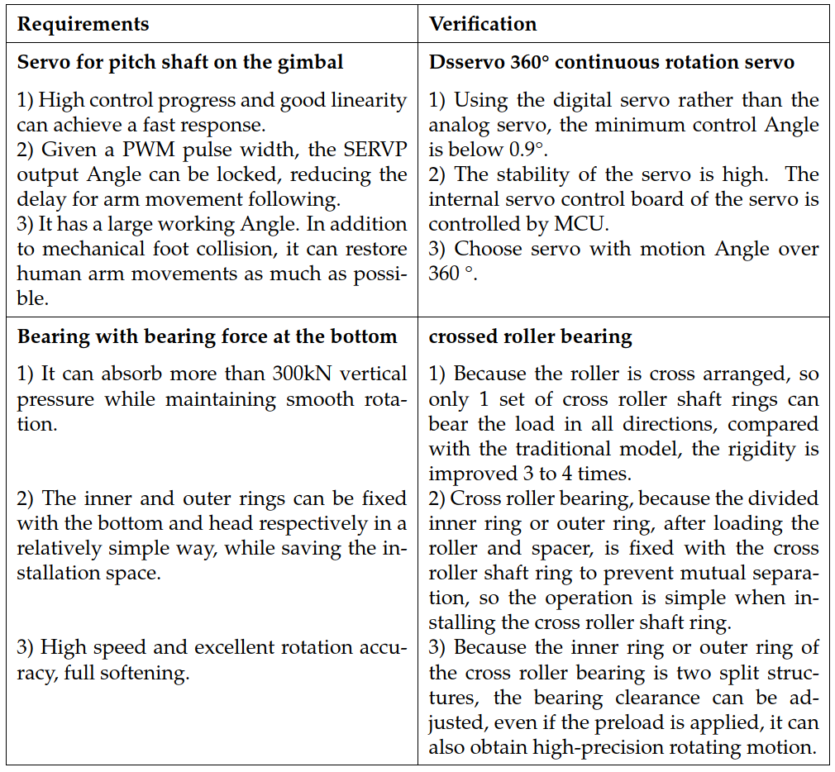
Requirements and Verification – Lighting Subsystem
Notes:
Requirements and Verification – Lighting Subsystem

Slide 63

Requirements and Verification – Lighting Subsystem
Notes:
Requirements and Verification – Lighting Subsystem

Slide 64

Requirements and Verification – Lighting Subsystem
Notes:
Requirements and Verification – Lighting Subsystem

Slide 65

Requirements and Verification – Music Analysis Subsystem
Notes:
Requirements and Verification – Music Analysis Subsystem

Slide 66

Requirements and Verification – Music Analysis Subsystem
Notes:
Requirements and Verification – Music Analysis Subsystem

